Slide 1
Meet the Teacher!
Welcome to Key Stage 1
Miss Kay and
Miss Brindle
.

Slide 2
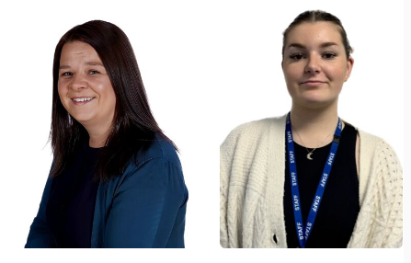
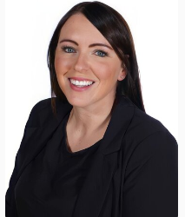
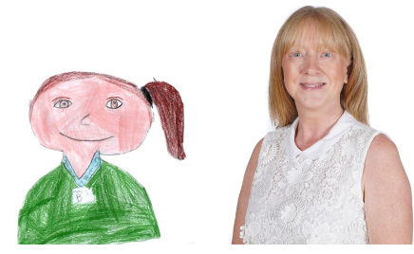
Other adults
Year 1 and Year 2
Year 1
Mrs Egan Miss Green Mrs Harrison
Year 2
Mrs Brownlie Mrs Wood Sam

Slide 3
Statutory Coverage KS1
Subjects are classed as ‘core’ and ‘foundation’.
Core Subjects: English, Mathematics & Science.
Year 1 will be continuing with provision as in reception to support the transition.
Foundation Subjects: Art and Design, Computing, Design and Technology, Geography, History, Music, Physical Education (PE).
Spanish, Computing and Music will be taught by specialists every Friday.
The curriculum must be ‘balanced and broadly based’.
This also includes Religious Education and PSHE (personal, social, health and economic education).
Key Stage 1: Year 1 & 2 (Age 5-7)

Slide 4
How to Help Your Child with Reading
Listening to your child read can take many forms.
First and foremost, focus developing an enjoyment and love of reading.
Enjoy stories together – reading stories to your child at KS1 and KS2 is equally as important as listening to your child read.
Read a little at a time but often, rather than rarely but for long periods of time!
Talk about the story before, during and afterwards – discuss the plot, the characters, their feelings and actions, how it makes you feel, predict what will happen and encourage your child to have their own opinions.
Look up definitions of words together – you could use a dictionary, the Internet or an app on a phone or tablet.
All reading is valuable – it doesn’t have to be just stories. Reading can involve anything from fiction and non-fiction, poetry, newspapers, magazines, football programmes, TV guides.
Visit the local library - it’s free!

Slide 5
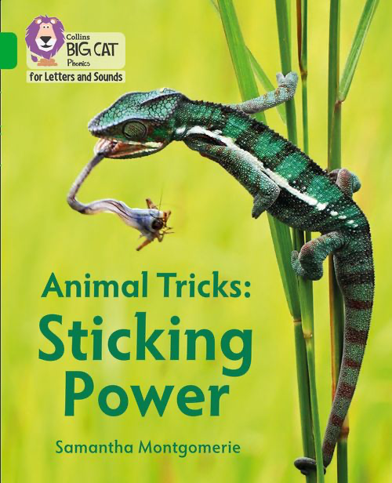
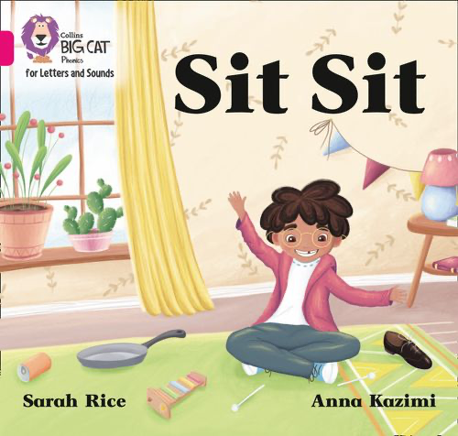
How do we teach reading in books?
Reading practice sessions are:
timetabled three times a week
taught by a trained teacher/teaching assistant
taught in small groups.
Notes:
The children read the same book three times in a week. The first time we work on decoding (sounding out) the words, the second time we work on prosody which is reading with expression – making the book sound more interesting with our story-teller voice or our David Attenborough voice – and the third time we look at comprehension. We read the books three times at school because we want to develop the fluency. The more they see words the more they begin to read them automatically without having to sound them out.

Slide 6
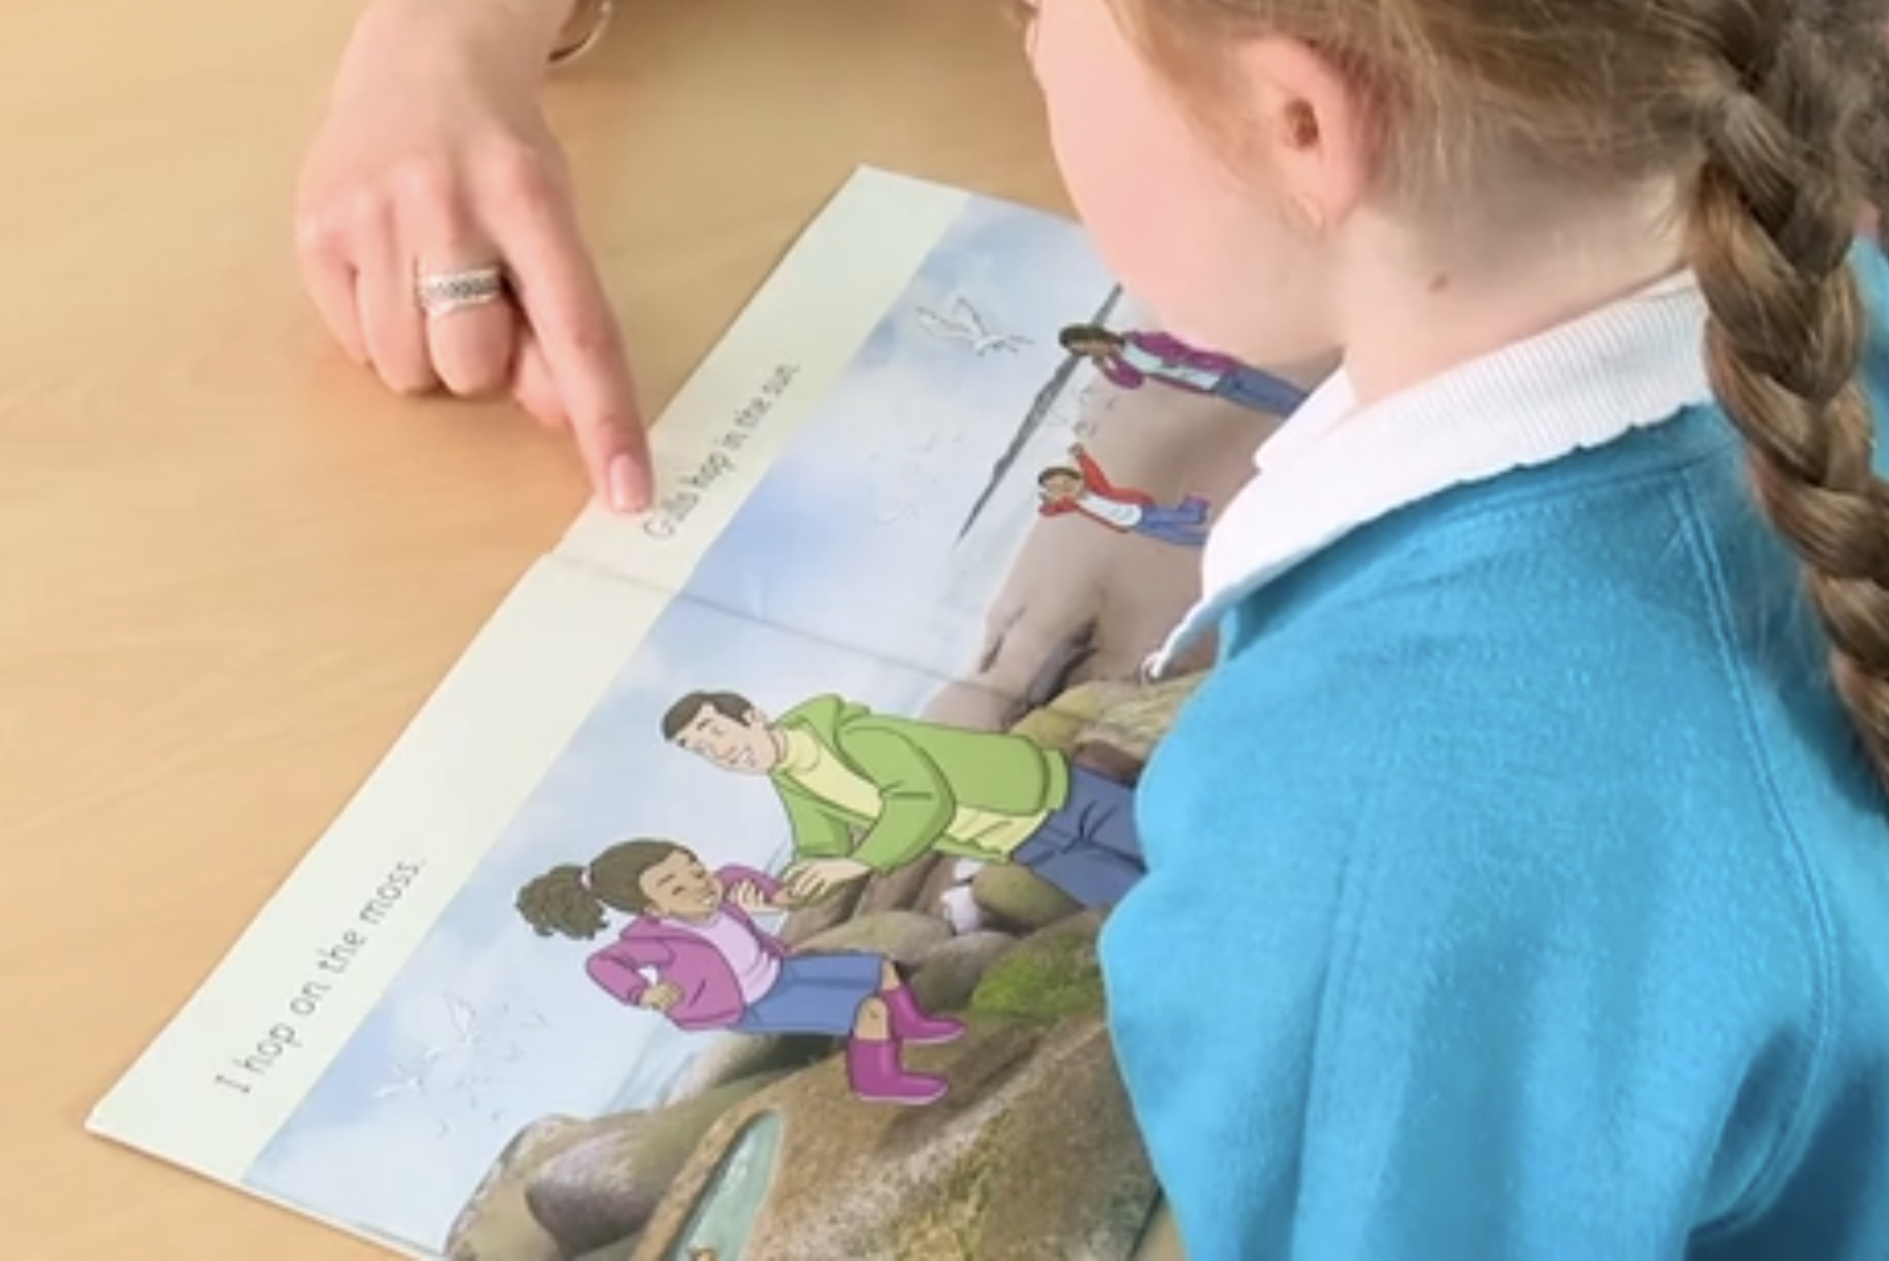
Reading a book at the right level
This means that your child should:
- Know all the sounds and tricky words in their phonics book well
- Read many of the words by silent blending (in their head) – their reading will be automatic
- Only need to stop and sound out about 5% of the words by the time they bring the book home – but they should be able to do this on their own.

Slide 7
Read to your child
Make the story sound as exciting as you can by changing your voice.
Talk with your child as much as you can:
Introduce new and exciting language
Encourage your child to use new vocabulary
Make up sentences together
Find different words to use
Describe things you see.

Slide 8
How to Help Your Child with Writing
Practise and learn weekly spelling lists – make it fun!
Encourage opportunities for writing such as letters to family or friends, shopping lists, notes or reminders, stories or poems.
Write together – be a good role model for writing.
Encourage use of a dictionary to check spelling and a thesaurus to find synonyms and expand vocabulary.
Allow your child to use a computer for word processing, which will allow for editing and correcting of errors without lots of crossing out.
Remember that good readers become good writers! Identify good writing features when reading (e.g. vocabulary, sentence structure, punctuation).
Show your appreciation: praise and encourage, even for small successes!

Slide 9
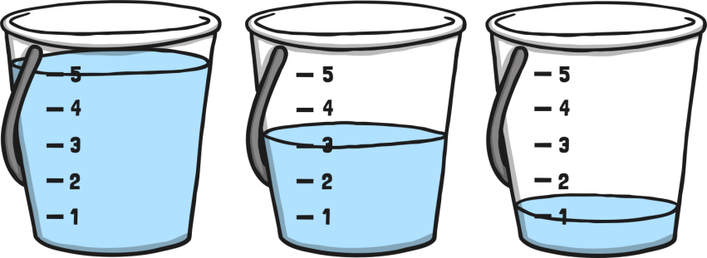
How to Help Your Child with Maths
Play number bonds/times tables games.
Play mental maths games including counting in different amounts, forwards and backwards.
Encourage opportunities for telling the time.
Encourage opportunities for counting coins and money; finding amounts or calculating change when shopping.
Look for numbers on street signs, car registrations and anywhere else!
Look for examples of 2D and 3D shapes around the home.
Identify, weigh or measure quantities and amounts in the kitchen or in recipes.
Play games involving numbers or logic, such as dominoes, card games, darts, draughts or chess.

Slide 10
Working Together
Ensuring book bags are in school every day
Returning reading practice books on time
Not taking holidays in school time
Arriving on time to school
Attending parents evening
We will always keep you informed and will strive to meet the individual needs of your child

Slide 11
Homework in Key Stage 1
Your child is expected to read at home. Each time you read with your child please sign their reading record. A comment about their reading is encouraged.
Spellings are given out weekly.
Number work in maths.
Download 1-Minute Maths

Slide 12
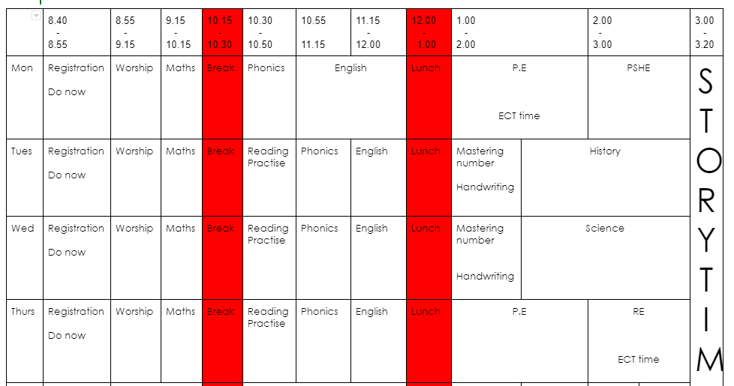
Class Timetable Year 1

Slide 13
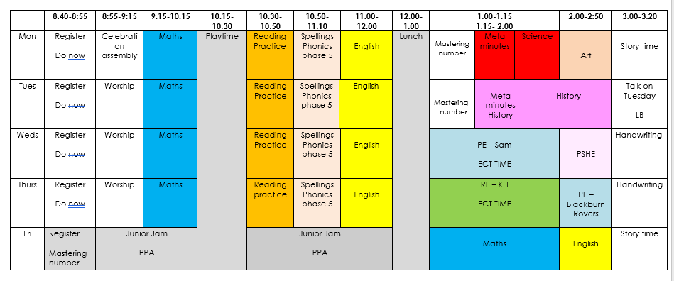
Class Timetable Year 2

Slide 14
Rewards
Dojo points – end of term rewards
Head teacher's Award
Stars of the week

Slide 15
ALWAYS badges
Our behaviour policy supports the school’s four rights:
All pupils ALWAYS have a right to learn
All adults ALWAYS have a right to do their job
Everybody ALWAYS has a right to dignity and respect
Everybody ALWAYS has a right to feel safe and be healthy

Slide 16
Important Reminders
Please can you ensure every item of clothing has your child’s name in it.
PE Kit must always be in school for PE.
Year 1 – Monday and Thursday
Year 2 – Wednesday and Thursday
Reading bags must be brought into school everyday.
Please make sure we are aware of any medical details your child has or may develop throughout the year to ensure the appropriate forms are signed.

Slide 17
Let’s stay connected!
Look out to see what we have been up to in class, updates and ideas
to support your child’s learning.
You can message teaching staff on here but please be mindful of our working hours, but we will get back to you as soon as possible.

Slide 18
Thank you for listening ☺
Any Questions?

